Slide 1
Matching Blessing Education

Slide 3
Kings and Queens of Cheon Il Guk
Only after realizing the Four Great Realms of Heart and the Three Generation Kingships, can we enter the realm of the royal family, or the Royal Clan. CSG Page 2460
Cheon Il Guk is the nation in which two people become one. CSG Page 2387
Genesis 1:28
And God blessed them, and God said unto them, Be fruitful, and multiply, and replenish the earth, and subdue it: and have dominion over the fish of the sea, and over the fowl of the air, and over every living thing that moveth upon the earth. (KJV)

Slide 4
CSG Page 1289
Protecting and guarding the chastity of men and women is the same as protecting the universe. This is because the order of love between men and women is the basis of the universe.
The sexual organ is more important than the head. You cannot find the origin
of true love in your head. You cannot find the origin of true life in your
head. You cannot find the origin of true lineage in your head. Where is this origin,
then? It is in the sexual organs. Isn’t that only too true? Everything can be
found in the sexual organs – life, love, and lineage. It is the main palace of love.
You can find the root of life there. It is the same in the case of the lineage. The
sexual organ is the most precious part of the human body as well as the human
world and history of humanity. Without it, reproduction of humankind would be
impossible. (203-104, 1990.6.17)

Slide 5
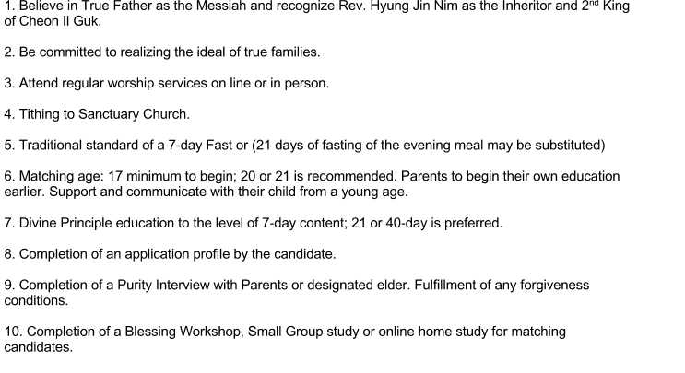
Recommendations for Blessing Nr 1 is a must.

Slide 6
Recommendation for Blessing Continued
11. Health Check up.
12. Aids and other sexual transmitted diseases test.
13. If applicable sickle cell test
14. Study Dr Emmerson Eggerich’s book or DVD about Love and Respect.

Slide 7
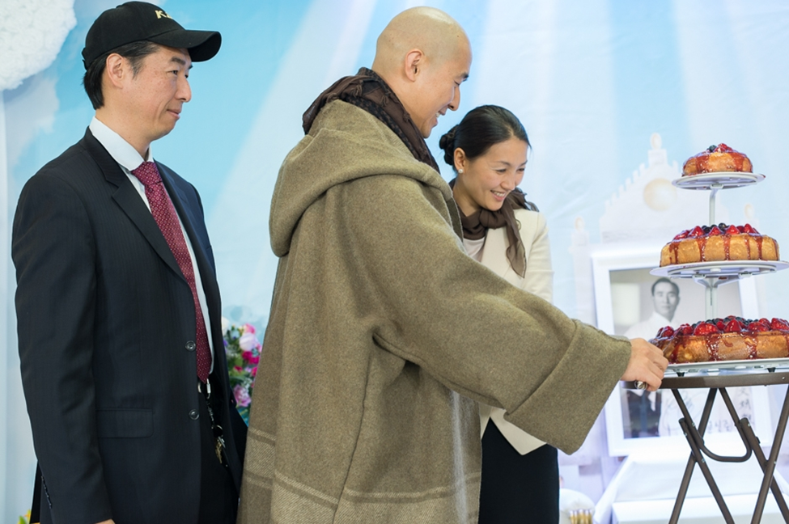
Happy Couple plus united Cain and Abel.

Slide 8
Watch King’s report on 2017.03.31
Value of Man
Testimony of Kings Blessing.
Choose to Grasp in faith Spirit of Victory of God.
Do not listen to Satan (Blame, Defeat, Looser, Belittle, Self Pity)
12:20-27:25 and 45:43- 49

Slide 9
Resources and Tools The 8 Great Text Books
Divine Principle: Principle of Creation, Fall of Man.
Cheon Seon Gyeong: Ch. 9 Blessed Family and Ch.11 The Root of the Universe. Ch. 16 True Families and the Family Pledge
Prayer.
Rhema : Open the Bible or DP or CSG and find God’s word for you.( When confused, when in dispute with loved ones, when in need of new focus in life.)

Slide 10
Conditions of Spiritual &Physical Restoration in Marriage Blessing
Holy Wine Ceremony : In the first of the two Change of Blood Lineage ceremonies, we drink the Holy Wine which represents literally taking the blood of Christ into our bodies for the forgiveness of our sins and becoming part of His lineage. He claims us. We are adopted.(Jim Stephens)
Chastening Ceremony : “All men and women in human history have misused the hip bone, and thus man has resentment against woman and woman against man. Without dissolving this resentment, you cannot stand as an original couple who is free of this resentment. Since this resentment came about through woman, the man hits the woman first. The three strikes represent three stages and three ages.” Blessing and Ideal Family (Part 1,7) By Rev Sun Myung Moon
Holy Marriage Blessing. 4 Vows
1) As a mature man and woman completing God’s the ideal of creation do you promise in the presents of God and True Parents to establish, the bond of eternal husband and wife?
2) Do you promise to become true parents who raise children in alignment with the Will of God, and educate them to become leaders needed by the entire Unification Family, humanity and God?
3) Do you promise to inherit the tradition of the Unification Family centering on True Parents, and pass on a proud tradition to the future generations of the Unification Family and humankind?
4) Do you promise to inherit the Will of God and True Parents centering upon the ideal of creation, so as to love the people of the world in the same manner as God and True Parents , and to form an ideal family that will be the basis for building the Kingdom of God on Earth and in Heaven?
40 Day Celibacy after the Blessing to restore the 4000 years of History before 3 Day Ceremony
3 Day Ceremony (see below)

Slide 11
3 Day Ceremony Watch April 21st 2015 explantion about value and how ro do 3 Day Ceremony. First 31 min
“Due to the Fall God’s Blood lineage was lost to the dominion of Satan. Mankind must be restored unto God the Father and Christ the Son of God. The Messiah is the Bridegroom and must meet His Bride. A Blessed Couple is in the position of the Bride that has been wed to Christ. Specifically the wife stands in the position of fallen woman or Eve and the husband in the position of fallen Archangel. Christ stands in the position of perfect Man and perfect Adam.
Through the 3-day ceremony the wife is reborn in Christ as the restored Bride of Christ and is bestowed to the husband as a princess in the Kingdom of God. The husband is reborn in Christ as the Son of God and the prince in the Kingdom of Heaven. After the Completion of these Holy consecrations the husband and wife will stand as prince and princess of God’s Kingdom to glorify and honor him forever.”
Rev. Hyung Jin Moon April 21, 2015

Slide 12
.
Ruling 2
The Blessing for Returning to True Father’s Authority
The 2nd King of Cheon Il Guk has clearly explained that Han mother left her position as True Mother after True Father’s Seonghwa (ascension). All decisions she has made after September 3, 2012, are not valid. The “Foundation Day” held in February 2013 centering on Han Hak Ja was a false “Foundation Day.” Those who drank the “Holy Wine” given out by FFWPU or participated in this ceremony in February 2013 lost their Blessing status to Satan. These families need to go through the change of blood lineage process again. This means to receive the true Holy Wine, participate in a Holy Blessing Ceremony conducted under True Father’s authority, do the indemnity Stick Ceremony, go through the 40 day period of separation and conduct the 3-Day Ceremony. The same applies to people who participated in FFWPU “blessings” after February 2013. In order to return to True Father’s Authority, one must be blessed using the instruction given on the April 21, 2015 Blessing. If there is an error committed during 40 day separation or 3-Day Ceremony, a continental coordinator of Unification Sanctuary can decide the condition to restore such failure.
WHO IS 1ST GEN AND WHO IS 2ND GEN.
( The 2nd gen who took holy wine from Han mother and did not receive Holy Wine from 2nd King before Feb 13th 2016 are now 1st gen. If they stayed pure they can be Blessed to Sanctuary 2nd gen and regain 2nd gen status as a couple.
2nd gen who fell became 1st and stay 1st gen.
They can still be Blessed as a 1st gen couple and then go through Holy Wine Ceremony,,Holy Blessing, Indemnity stick, 40 Day separation and 3 day ceremony and continue God’s lineage. Comment by Dorit Smith)

Slide 13
Ruling 8
What Constitutes a Fall?
Any sex outside a Blessed marriage is not ordained by God. Sex is determined as willful touching of another’s sexual organs, vaginal intercourse, anal, oral or otherwise even through clothing. This includes any and all forms of homosexual or lesbian sexual activity, Artificially Intelligent substitutes for humans, animals and any genetically modified biological living organisms. These constitute the Fall. Accidental touching, a medical examination and victims of sexual assault or rape are not the Fall. A second generation person who engages in any of these behaviors becomes a first generation person and needs to Take Holy Wine, Attend the Blessing. Do indemnity stick Ceremony. Do a 40 day separation condition and the 3-Day Ceremony. This Blessing must be done according to Unification Sanctuary standard.

Slide 14
True Father’s secret to CIG Interracial International Blessings

Slide 15
Heavenly Father’s Gift to us.
Our Spouse and Children are gifts from Heavenly Father to each of us.
Heavenly Father has prepared a match for each candidate. We just have to find the match and try to see each other from God’s point of View. God gave the Matching responsibility to the Parents.
Our Blessing is Heavenly Father’s Blessing.

Slide 16
Let God be your Guide. The End

Slide 17
‘Love and Respect; by Dr Emmerson Eggerichs
Ephesian 5:33 : ‘However each one of you also must love his wife as he loves himself and the wife must respect her husband.’
Read Eph 5: 21-33

Slide 18
Wife’s Love and Husband’s respect need.( Dr. Emmerson Eggerichs)
COUPLE- How to spell LOVE to Your Wife
Closeness- She Wants You to be Close.
Openness- She Wants You to Open up to Her.
Understanding-Don’t Try to Fix Her. Listen to Her
Peacemaking- She Wants You To say. I’m Sorry
Loyalty-She Needs to Know You’re Committed
Esteem- She Wants You to Honor and Cherish her.
CHAIRS- How to spell RESPECT to Your Husband Conquest- Appreciate His Desire to Work and Achieve.
Hierarchy- Appreciate His Desire to Protect and Provide.
Authority- Appreciate His Desire to Serve and to Lead
Insight- Appreciate His Desire to Analyze and Counsel
Relationship-Appreciate His Desire for Shoulder to Shoulder Friendship.
Sexuality- Appreciate His Desire for Sexual Intimacy.

Slide 19
Relationship skills
A.Showing Understanding:
James 1:19:…..let every man be swift to hear, slow to speak, slow to wrath.KJV
1. Listen in a way that shows strong interest.
2.Become your partner. Put yourself in their shoes.
3. Name back what you heard them say like thoughts, feelings,concerns and desires.
4. Accept and make corrections graciously.
B. Expression Skill:
Ephesian 4:29,31-32 : Let no corrupt communication proceed out of your mouth, but that which is good to the use of edifying, that it may minister grace unto the hearers……..
1.Think before you speak.
2. Start by remembering what is good.
3. Speak from your point of view.
4.Talk about your feeling and all that is important to you.
5. Ask for what you want be specific.
6. Avoid trigger words like always, never and name calling

Slide 20
Communication Skills
C. Discussion skill
Gal 5:14 For all the law is fulfilled in one word, even in this; Thou shalt love thy neighbour as thyself. KJV
1. Agree with your partner on a time and place.
2. One Partner start by expressing thoughts, feelings, concerns, desires.
3.The other partner shows understanding.
4. From time to time trade places as needed when understood or when want to express.
D. Problem Solving Skill.
James 1:5 If any of you lack wisdom, let him ask of God, that giveth to all men liberally and it shall be given to him.
1. Agree with your partner on a time and place.
2. If angry take a Time Out cool down first.
3. Show respect.
3. Go to God together find a Rhema in Bible, CSG or DP
4. Use Discussion skill above.
5. Pray together ask God’s guldens.
5

Slide 21
“The 5 Love languages” by Gary Chapman.
Questionnaire? Which one is your main one?
1. Words of affirmation
2. Quality Time
3. Receiving Gifts
4. Acts of Service
5. Physical Touch

Slide 22
“The Five Languages of Apology” by Gary Chapman & Jennifer Thomas
1. Expressing Regret
“I am sorry”
2. Accept Responsibility
“I was wrong”
3. Making Restitution
“What can I do to make it right?”
4. Genuinely Repenting
“I’ll try not to do that again.”
5.Requesting Forgiveness. “Will you please forgive me?”

Slide 23
“The First Five Years of Marriage.” Complete Guide by Focus on the Family.
1. Getting to know each other.
2. Expectations.
3. Roles.
4. Money
5. Sex.
6. Communication.
7. Resolving Conflict.
8. Spiritual Issues.
9. In Laws.
10. Children.
11. Sticking With It.

